Slide 1
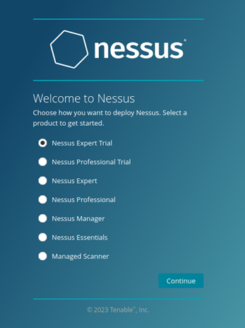

Unveiling Digital Vulnerabilities with Tenable Nessus
This presentation explores how Tenable Nessus proactively identifies and addresses security weaknesses. We will cover its core functionalities and demonstrate a basic network scan.
28811 : Anuj Sen

Slide 2
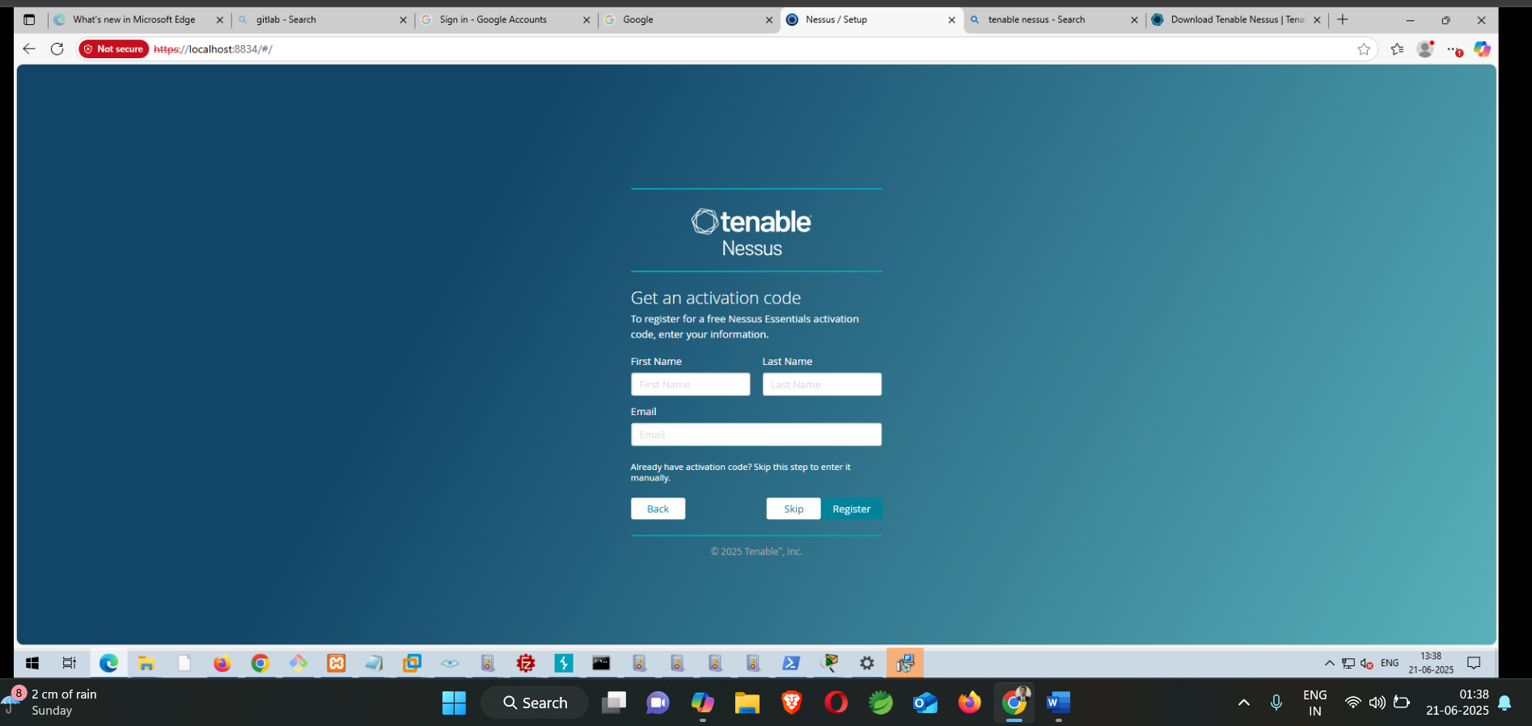

Slide 3
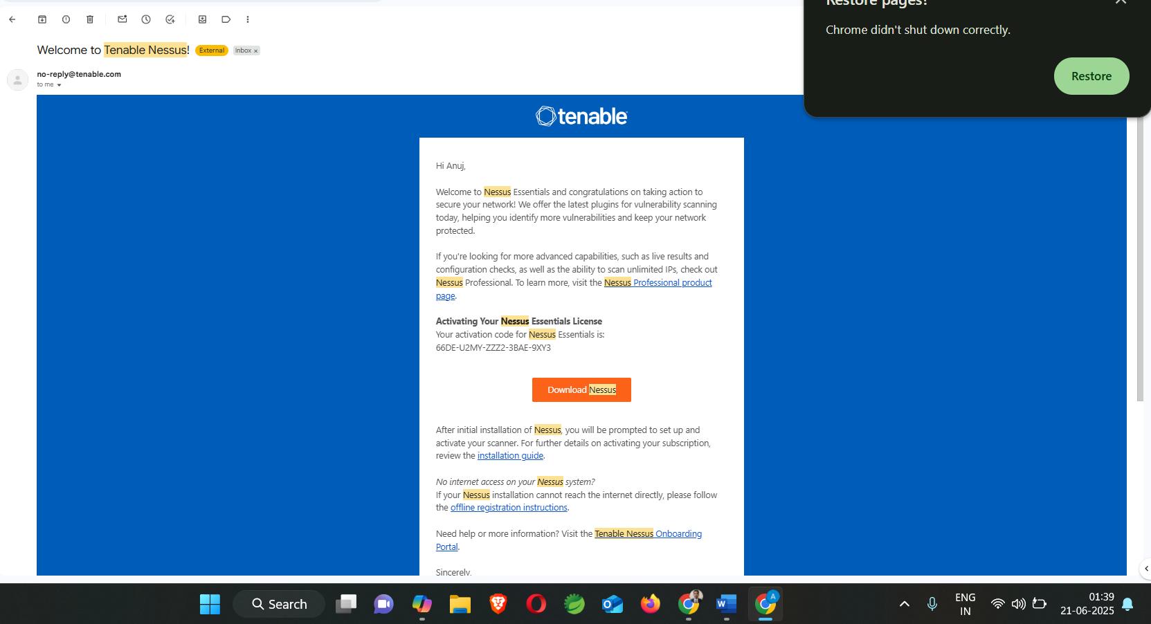

Slide 4




What is Tenable Nessus?
Vulnerability Scanner
Nessus identifies security weaknesses in systems.
Network & Application Security
It scans networks, applications, and devices for flaws.
Proactive Risk Mitigation
It helps organizations fix issues before exploitation.
Tenable Nessus is a leading solution for comprehensive vulnerability assessment, protecting digital assets from various threats.

Slide 5
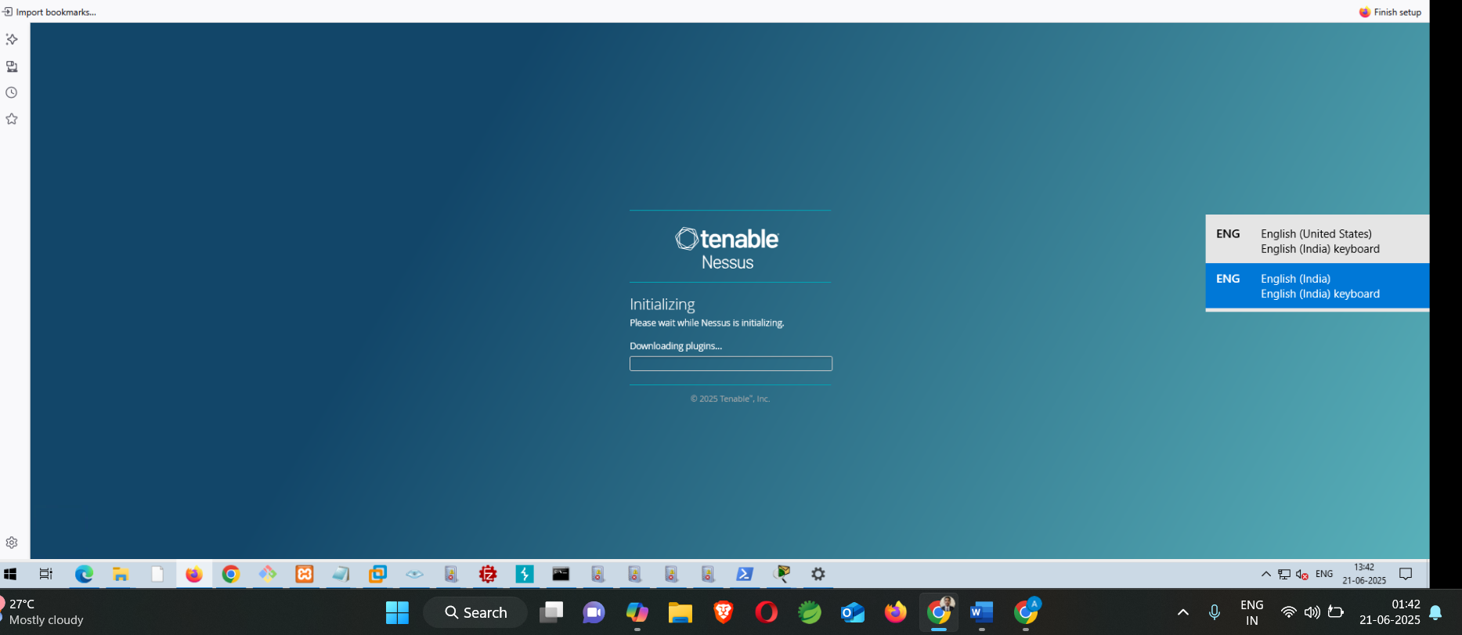

Slide 6


Key Capabilities
1
Comprehensive Scanning
Scans a wide range of IT assets.
2
Patch Management
Identifies missing patches and updates.
3
Configuration Auditing
Checks for misconfigurations and compliance.
4
Web Application Testing
Finds vulnerabilities in web applications.
Nessus offers deep insights into your security posture across diverse environments.

Slide 7
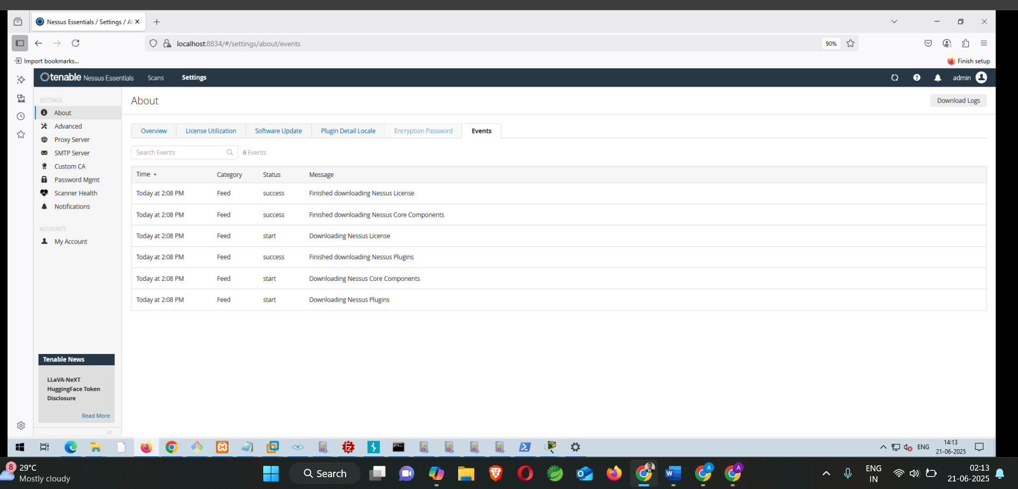

Slide 8
Basic Network Scan Steps
Create New Scan
Select "Basic Network Scan" to begin.
Name the Scan
Assign a descriptive name, like "TestScan".
Define Targets
Specify IP addresses or URLs for scanning.
Configure Discovery
Set port scan options for common ports.
Review Assessment
Keep "Default" settings for initial assessment.
These initial steps are crucial for setting up an effective vulnerability scan.

Slide 9


Configuring the Basic Network Scan
Scan Details: "TestScan"
Target Identification
Target IPs: Your Target IP for Scanning
URL: demo.testfire.net
We'll name our scan "TestScan" for easy identification and organization.
Clearly defining targets ensures comprehensive coverage of assets.
Accurate target specification is vital for a thorough and relevant vulnerability assessment.

Slide 10

Discovery and Assessment Settings
Discovery Section: Port Scan
Configure Nessus to scan common ports. This identifies open services on your targets, which might indicate potential vulnerabilities.
Scanning common ports is a fundamental step in network reconnaissance.
Assessment Section: Default
Utilize the default assessment policies. These pre-configured settings offer a balanced approach for initial scans, covering a wide range of common vulnerabilities.
Default settings provide a solid baseline for vulnerability detection.
These settings allow Nessus to efficiently discover and assess potential security weaknesses.

Slide 11




Advanced Scan Configuration
Advanced Settings Tab
Scan Low Bandwidth Links
Optimized Scanning
Navigate to the "Advanced" tab within the scan configuration.
Enable this option for network segments with limited bandwidth. This prevents network congestion.
Ensures efficient scanning without impacting network performance.
Adjusting advanced settings allows for tailored and optimized scanning in various network environments.

Slide 12
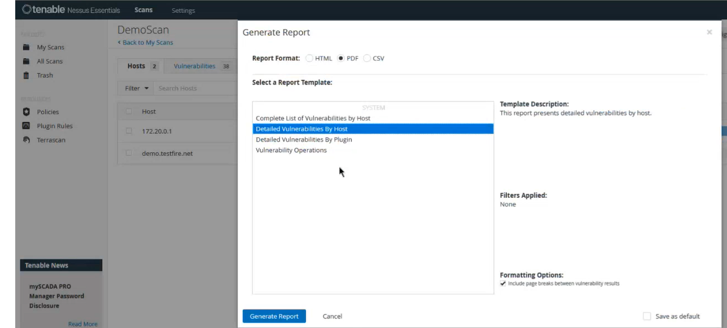

Slide 13
Key Takeaways and Next Steps
Nessus Empowers Proactive Security
It's an essential tool for identifying weaknesses.
Customizable Scanning for Specific Needs
Settings can be adjusted for various network conditions.
Next Steps:
Run your first "TestScan"
Start Simple, Then Explore Depth
Analyze the scan results
Begin with basic scans, then delve into advanced features.
Prioritize and remediate vulnerabilities
Explore advanced scan templates
Embrace Nessus to strengthen your organization's cybersecurity posture.
https://www.digitalocean.com/community/tutorials/how-to-use-nessus-for-vulnerability-scanning-on-ubuntu-2204

